Slide 1

Innovate, Collaborate & Accelerate

Slide 2
Index
What are Docker volume.
How to create / list /delete volumes
How to attach volume to a container
How to share volume to among containers
Additional command

Slide 3
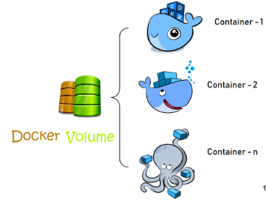
What is Docker Volume?
Volumes are the preferred mechanism for persisting data generated by and used by Docker containers

Slide 4
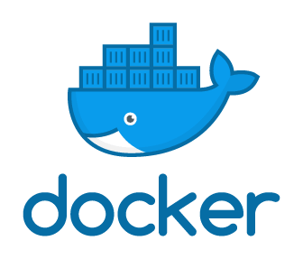
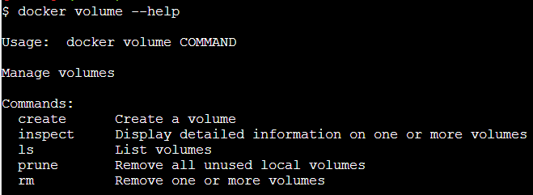
Docker Volume Help
Try to download the Image from Docker Hub
Name of Image to download
Reference the Docker client
docker
volume
-- help

Slide 5

List Docker Volume
Reference the Docker client
Reference the Volume
List the volume
docker
volume
ls

Slide 6
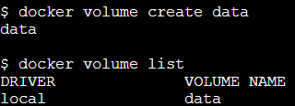
Create Docker Volume
Reference the Docker client
Reference the Volume
Create the Volume
Name of Volume
docker
volume
create
data

Slide 7
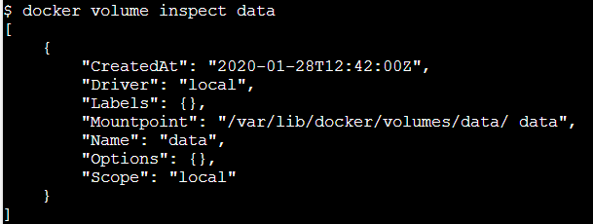
Inspect Docker Volume
Reference the Docker client
Reference the Volume
Inspect the Volume
Name of Volume
docker
volume
inspect
data

Slide 8
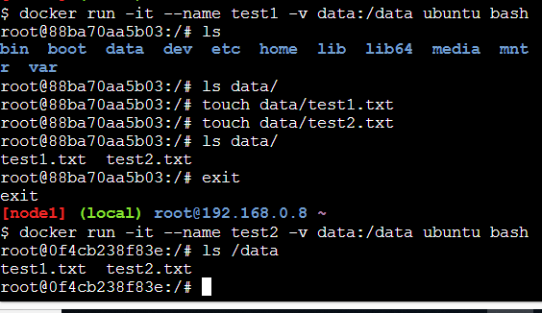
Attaché and Share Docker Volume

Slide 9
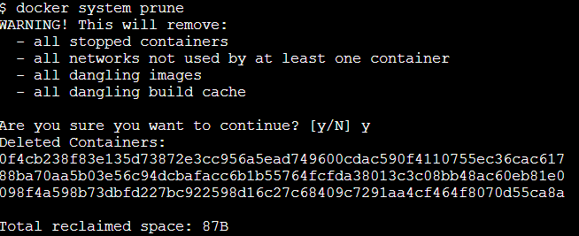
Attaché and Share Docker Volume

Slide 10
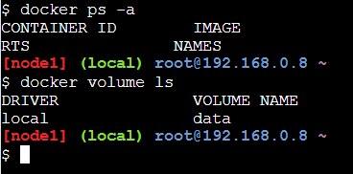
Even Container Delete , Volume Remains There

Slide 11

Remove Docker Volume
Reference the Docker client
Reference the Volume
Remove the Volume
Name of Volume
docker
volume
rm
data

Slide 12
What you Learn?

